Slide 1


Music Store Data Analysis
SQL Project by Akshay Gaikwad

Slide 2
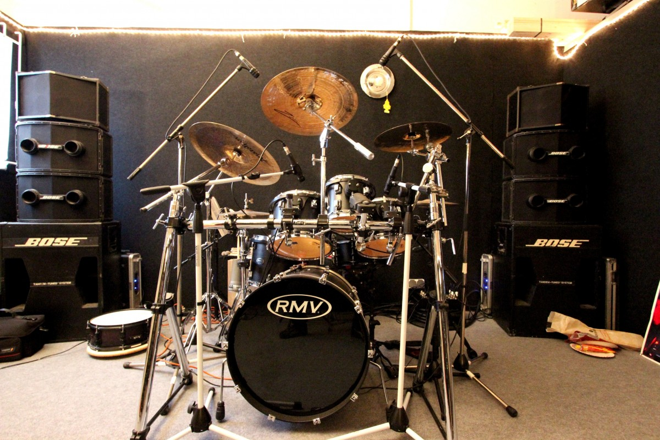
OBJECTIVE
The objective of this analysis is to help music store overcome its challenges and help them to grow their business

Slide 3
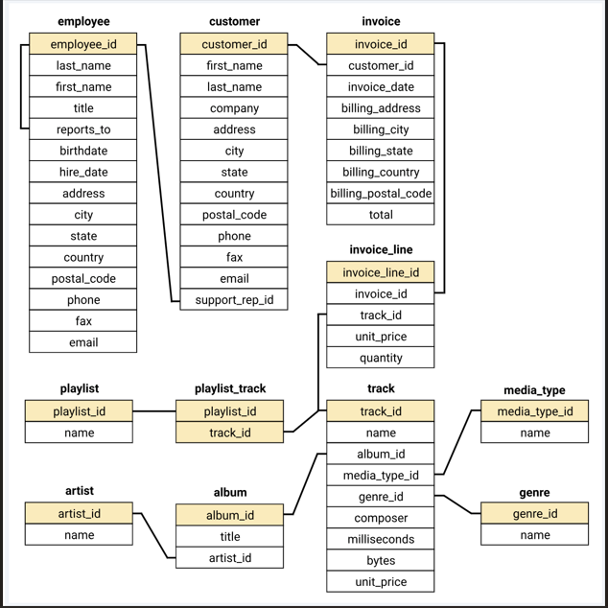
DATABASE
SCHEMA

Slide 4
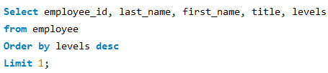
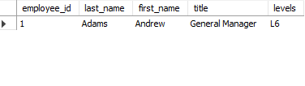
Q1: Who is the senior most employee based on job title?
Solution
Result

Slide 5
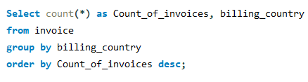
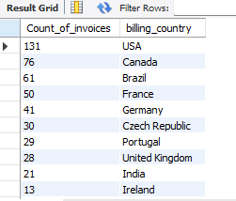
Q2: Which countries have the most Invoices?
Solution
Result

Slide 6
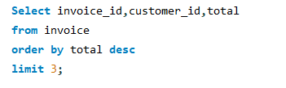
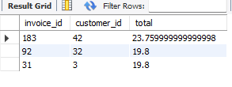
Q3: What are top 3 values of total invoice
Solution
Result

Slide 7
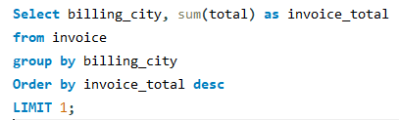
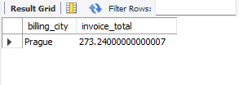
Q4: Which city has the best customers? We would like to throw a promotional Music Festival in the city we made the most money. Write a query that returns one city that has the highest sum of invoice totals. Return both the city name & sum of all invoice totals
Solution
Result

Slide 8
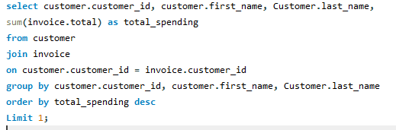
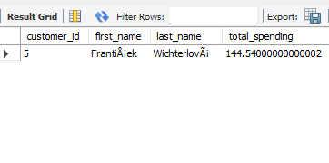
Q5: Who is the best customer? The customer who has spent the most money will be declared the best customer. Write a query that returns the person who has spent the most money.
Solution
Result

Slide 9
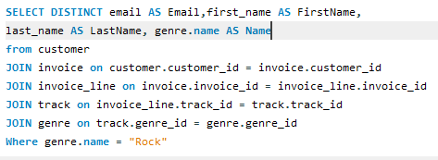
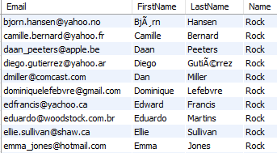
Q6: Write query to return the email, first name, last name, & Genre of all Rock Music listeners. Return your list ordered alphabetically by email starting with A.
Solution
Result

Slide 10
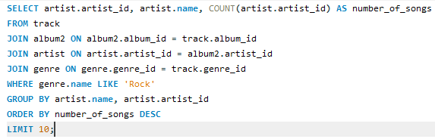
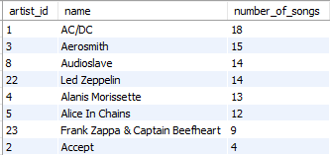
Q7: Let's invite the artists who have written the most rock music in our dataset. Write a query that returns the Artist name and total track count of the top 10 rock bands.
Solution
Result

Slide 11
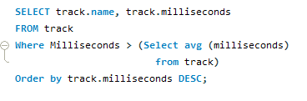
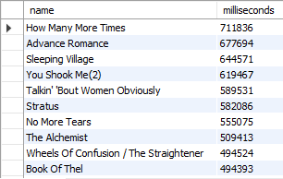
Q8: Return all the track names that have a song length longer than the average song length. Return the Name and Milliseconds for each track. Order by the song length with the longest songs listed first.
Solution
Result

Slide 12
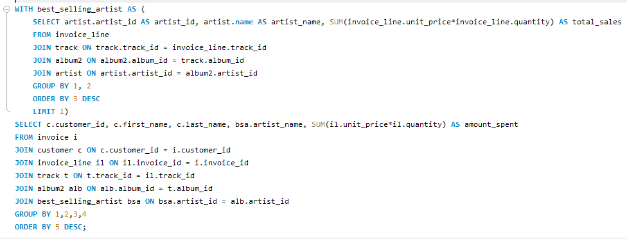
Q9: Find how much amount spent by each customer on best selling artist? Write a query to return customer name, artist name and total spent
Solution

Slide 13
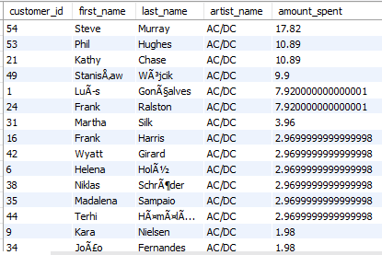
Result

Slide 14
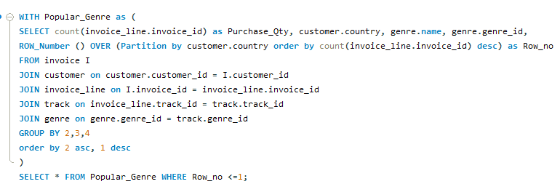
Q10: We want to find out the most popular music Genre for each country. We determine the most popular genre as the genre with the highest amount of purchases. Write a query that returns each country along with the top Genre. For countries where the maximum number of purchases is shared return all Genres.
Solution

Slide 15
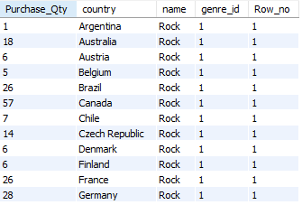
Result

Slide 16
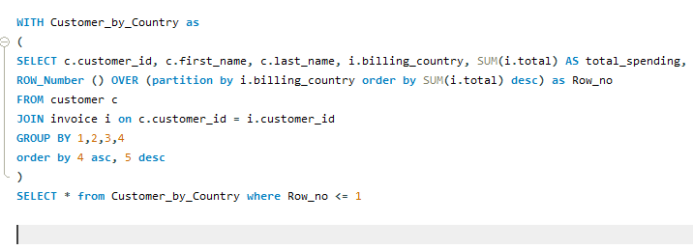
Q11: Write a query that determines the customer that has spent the most on music for each country. Write a query that returns the country along with the top customer and how much they spent. For countries where the top amount spent is shared, provide all customers who spent this amount.
Solution

Slide 17
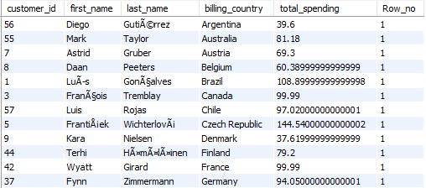
Result

Slide 18


